Slide 1
P2 - Global Sales Analysis ETL
End-to-End Data Pipeline using GCP for Sales Analytics & Forecasting

Slide 2
Introduction
In this project, we designed and implemented an end-to-end ETL pipeline on Google Cloud Platform (GCP) to unify and analyze multi-source, multilingual sales data from 8 global offices.
Sales records, collected in diverse data formats (CSV, JSON, SQL Server, MySQL, PostgreSQL, Excel), were ingested, cleaned, transformed, and converted to a common currency (INR) using Cloud Composer (Apache Airflow) orchestration.
The unified dataset was loaded into BigQuery for further analysis, visualization, and time-series forecasting.
The pipeline ensures data quality, schema standardization, and scalable processing, enabling real-time decision support for production planning.
Visual insights and tax computations were rendered via Looker Studio dashboards, empowering stakeholders with actionable intelligence.
This solution demonstrates the power of cloud-native architecture in building resilient, automated data workflows.
Strategic ETL Orchestration with Airflow
To orchestrate a scalable and modular data workflow, we selected Apache Airflow via Google Cloud Composer as the core automation engine.
Airflow enables us to define complex ETL pipelines as DAGs (Directed Acyclic Graphs) with clear task dependencies and scheduling.

Slide 3
Project Goals
The primary objective of this project is to establish a centralized data pipeline that integrates sales data from various sources, ensuring thorough cleaning, transformation, and consolidation into Indian Rupees (INR). This project aims to enhance the analytical capabilities of the organization by providing accurate and actionable insights into sales performance and future forecasting, enabling informed decision-making to optimize business strategies.

Slide 4
Project Contributors
Garry Felix (Data Ingestion Specialist)
Ahkalya (Data Engineering Lead)
Hema Chandra (Data Warehouse Architect)
Rahul Chandra (Forecasting & Automation Engineer)
Kamal Kumar (Visualization & Reporting Analyst)

Slide 5
Process of Development
Data Ingestion Sales data from 8 countries was collected daily in multiple formats: SQL (SQL Server, MySQL, PostgreSQL), CSV, JSON, and Excel.
Cloud Storage & Database Setup Source files were stored in Google Cloud Storage, while structured data was ingested into Cloud SQL and AlloyDB instances for processing.
Workflow Orchestration Apache Airflow (Cloud Composer) was used to define and orchestrate the ETL pipeline, automating extraction, cleaning, transformation, and
loading tasks.
Data Cleaning & Transformation Each record was processed to handle null values, ensure schema standardization, and convert currency to INR using fixed exchange rates.
Centralized Data Warehouse Cleaned and unified data was loaded into BigQuery, serving as the central repository for analytics, visualization, and reporting.
Visualization & Reporting Interactive dashboards were created using Looker Studio, providing insights by product, country, and category, along with tax calculations (5%).
Forecasting & Decision Support Leveraging historical trends, predictive models were applied to forecast next month’s sales, aiding in strategic production and inventory planning.

Slide 6

Data Sources & Formats
Sales data is collected from multiple sources, including SQL Server, MySQL, and PostgreSQL (AlloyDB), along with file formats like CSV and Excel. The challenge lies in the variety of formats and the need for standardized data cleaning and transformation before analysis, particularly focusing on consolidating all figures into Indian Rupees (INR) for uniformity in reporting.
Technologies used
Google Cloud Platform (GCP): Cloud Storage, Cloud SQL, AlloyDB, BigQuery, Cloud Composer
Programming: Python
Data Orchestration: Apache Airflow
Visualization: Looker Studio
Modeling & Analytics: Pandas, NumPy
Data Formats: SQL, CSV, JSON, Excel

Slide 7
Data Collection & Cleaning
The data cleaning process is also orchestrated via the Airflow DAG file,The DAG ensures that cleaning tasks are executed sequentially
and reliably across all datasets. Key cleaning steps include:
Column and Schema Normalization: Ensures a unified schema across sources.
Missing Value Treatment: Drops records with critical missing fields and imputes others.
Duplicate Detection and Removal: Identifies duplicates using primary keys and timestamps.
Date Format Standardization: Converts all date fields to yyyy-MM-dd format.
Multilingual Text Cleaning: Normalizes encoding to handle international product descriptions.
Currency Flagging: Each record is tagged with its native currency for downstream INR conversion.
The use of Airflow DAGs ensures modularity, reusability, and monitoring of each task, making the cleaning process
scalable and maintainable.

Slide 8
Data Integration and Storage
As part of our project, we successfully designed and implemented a unified data warehouse schema in Google BigQuery, led by our Data Warehouse Architect. The schema was carefully structured to support seamless integration of sales data from eight different countries, each with varying formats including SQL, CSV, JSON, and Excel. We adopted a star schema approach to organize the data into fact and dimension tables, enabling efficient querying and analytical processing. Partitioning and clustering strategies were applied to optimize performance and reduce query costs. The schema was tailored to support downstream requirements such as currency conversion to INR, tax computation, and sales forecasting. Role-based access controls were implemented to ensure data security and compliance, and the architecture was designed to be fully compatible with our Airflow-managed ETL pipelines. This unified and scalable structure now serves as the single source of truth for global sales analysis and reporting.

Slide 9
Reporting & Forecasting
As part of the sales forecasting phase, we developed and deployed a machine learning model using BigQuery ML to predict future product quantities. The model was built using the linear regression algorithm, with Qty as the target variable. Key input features included Category, Product, INR_Amount, and Year, which were selected based on their influence on sales behavior. The model was trained on historical sales data hosted in BigQuery and automatically handled feature encoding and normalization.
Once trained, the model was evaluated using ML.EVALUATE to assess its accuracy and overall performance metrics, ensuring its reliability for business use. After validation, we conducted inference using ML.PREDICT to forecast sales for specific product scenarios, providing insights into expected quantities based on planned investment and time frame. This approach enables data-driven demand planning and helps stakeholders make informed decisions for inventory and marketing strategies.

Slide 10

Data Storage & Visualization
After cleaning, the unified data is stored in Google BigQuery to facilitate fast querying and analysis. Visualization tools, such as Google Data Studio or Looker Studio, are then employed to create interactive dashboards that not only display sales metrics but also provide insights into trends and forecasts. These visualizations help stakeholders monitor key performance indicators effectively.

Slide 11
Sample Visualization Reports
The ingested sales data from eight different countries was projected to show the volume and distribution across regions. This visual representation highlights the daily data flow and contributions from each country to the unified data pipeline.

Slide 12
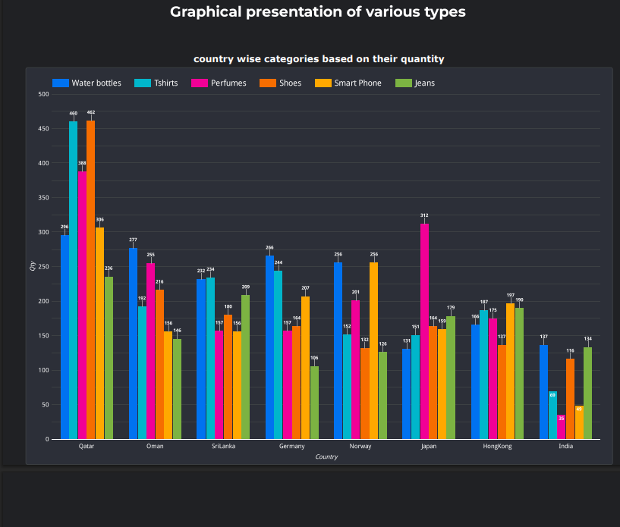
Stakeholder’s requirements
Stakeholders require visual insights, we have provided graphical representations categorized by product type, country, and other key dimensions to support better understanding and decision-making.

Slide 13
To support the Tax Department's requirements, we generated detailed visualizations and tables that display sales data segmented by country, product, and category. Each view includes the corresponding tax amounts, calculated at a uniform 5% rate on total sales, ensuring transparent and actionable insights for tax reporting and compliance.

Slide 14
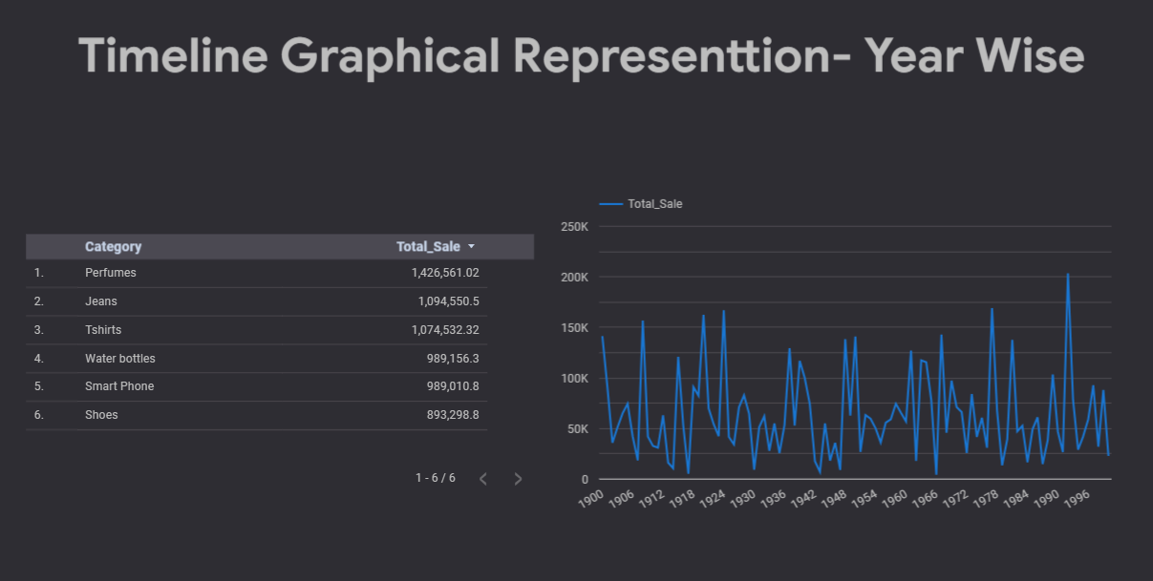
Year and Category Wise Sales
The year and category-wise sales graphical representation provides a clear overview of sales trends across different product categories over time. By visualizing sales data year-on-year, stakeholders can easily identify growth patterns, seasonal fluctuations, and category performance.

Slide 15
Future plans and enhancements
Integrate Real-Time Data Ingestion using streaming tools like Cloud Pub/Sub and Dataflow to enable near real-time analytics and forecasting.
Implement Advanced ML Models such as time-series forecasting (ARIMA, Prophet) or deep learning for improved sales prediction accuracy.
Expand Currency Conversion Support to include dynamic exchange rate integration for real-time INR value updates.
Enable Interactive Dashboards using Looker Studio or Power BI for live data visualization tailored to various stakeholder needs.
Automate Tax Filing Reports by generating scheduled tax summaries per country, compliant with local regulations, directly from BigQuery.

Slide 16

Conclusions
In conclusion, the successful implementation of this ETL pipeline will not only streamline data collection and reporting processes but also empower the organization with valuable insights. By centralizing data management and utilizing powerful visualization tools, the organization can enhance its decision-making capabilities, adapt to market changes rapidly, and optimize its forecasts and business operations.

Slide 17
Thank You
We would like to extend our heartfelt gratitude to our trainers Mr. Nikhil Shah and Ms. Remya Gopala Krishnan
for their invaluable guidance, expertise, and support throughout this project.
A special thanks to our co-trainers Mr. Udhaya Kumar and Mr. Rishi
for their consistent encouragement, technical assistance, and mentorship.
Your contribution has played a crucial role in our learning journey and the successful completion of this project.

